Slide 1
CONTENTS
The theoretical basis of FM_CC
Comparison of CC, CPCC, FM_CC, FM_CPCC
Plan

Slide 2
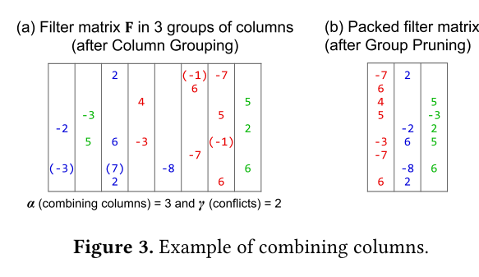
1. The theoretical basis of FM_CC
density<=1

Slide 3
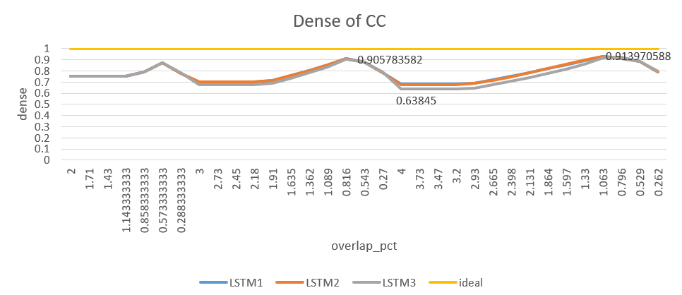
1. The theoretical basis of FM_CC

Slide 4
1. The theoretical basis of FM_CC
通过Fake Mask(FM)方法使density=1
Ren, Ao, et al. "DARB: A Density-Aware Regular-Block Pruning for Deep Neural Networks." AAAI2020

Slide 5
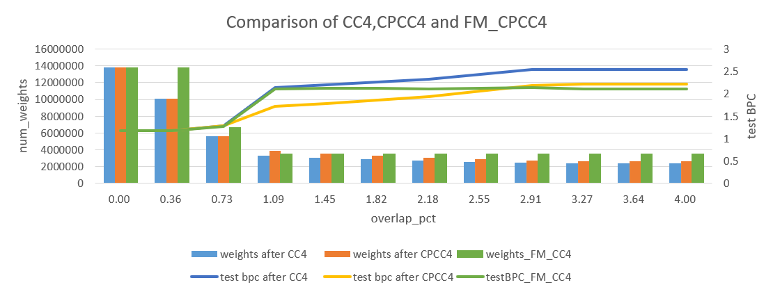
2. Comparison of CC, CPCC, FM_CC, FM_CPCC

Slide 6
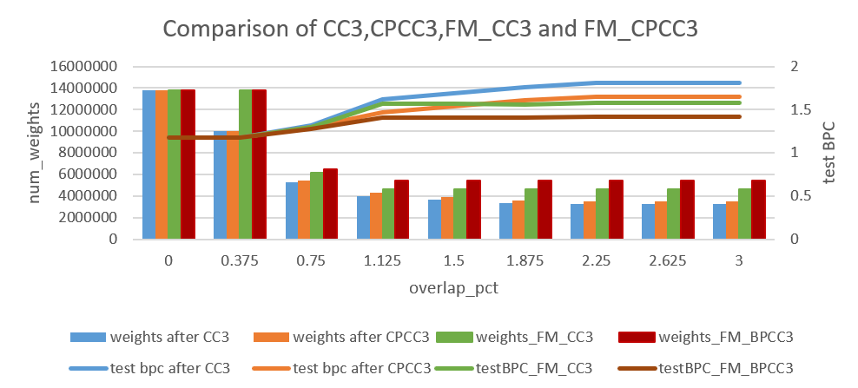
2. Comparison of CC, CPCC, FM_CC, FM_CPCC
dense-column-first or large-column-first?

Slide 7
3. Plan
Complete the block column combine
Keep on some experiments to optimize CC algorithm

